Slide 1
Chapter 12
Processor Structure and Function

Slide 2
Module 3- Central Processing Unit
3.1 | CPU architecture, Register organization, Instruction formats and addressing modes(Intel processor).,Basic instruction cycle. Control unit Operation ,Micro operations : Fetch, Indirect, Interrupt , Execute cycle Control of the processor, Functioning of micro programmed control unit, Micro instruction Execution and Sequencing, Applications of Micro programming
3.2 | RISC v/s CISC processors, RISC and CISC Architecture, RISC pipelining, Case study on SPARC

Slide 3
CPU Structure
CPU must:
Fetch instructions-reads an instruction from memory
Interpret instructions-instruction is decoded to determine what action is required.
Fetch data-The execution of an instruction may require reading data from memory or an I/O module
Process data-The execution of an instruction may require performing some arithmetic or logical operation on data
Write data-the results of an execution may require writing data to memory or an I/O module.

Slide 4
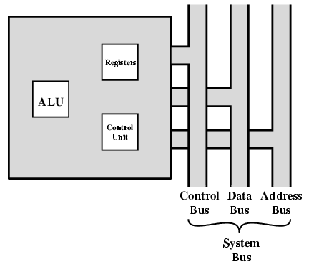
CPU With Systems Bus

Slide 5
The ALU does the actual computation or processing of data.
The control unit controls the movement of data and instructions into and out of the processor and controls the operation of the ALU.
In addition, there is a minimal internal memory, consisting of a set of storage locations, called registers

Slide 6
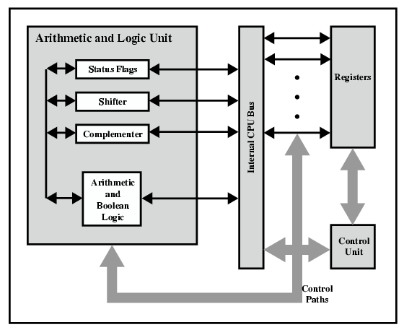
CPU Internal Structure

Slide 7
The data transfer and logic control paths are indicated, including an element labeled internal processor bus.
This element is needed to transfer data between the various registers and the ALU because the ALU in fact operates only on data in the internal processor memory.

Slide 8
Registers
CPU must have some working space (temporary storage)-Called registers
Number and function vary between processor designs
One of the major design decisions
Top level of memory hierarchy
The registers in the processor perform two roles:
User-visible registers: Enable the machine- or assembly language programmer to minimize main memory references by optimizing use of registers.
Control and status registers: Used by the control unit to control the operation of the processor and by privileged, operating system programs to control the execution of programs.

Slide 9
User Visible Registers
may be referenced by means of the machine language that the processor executes
General Purpose-can be assigned to a variety of functions by the programmer
Data-used only to hold data and cannot be employed in the calculation of an operand address
Address-somewhat general purpose, or they may be devoted to a particular addressing mode.
Segment pointers: In a machine with segmented addressing, a segment register holds the address of the base of the segment.
Index registers: These are used for indexed addressing and may be auto indexed.
Stack pointer-there is a dedicated register that points to the top of the stack.
Condition Codes- (Refer next slides)

Slide 10
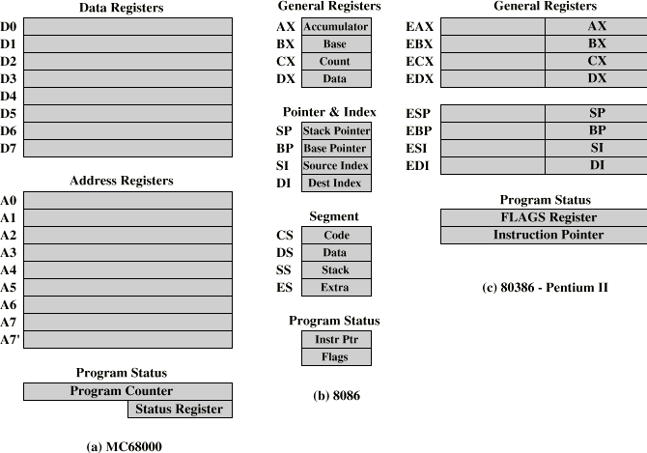
Example Register Organizations

Slide 11
The MC68000 partitions its 32-bit registers into eight data registers and nine address registers.
The eight data registers are used primarily for data manipulation and are also used in addressing as index registers.
The address registers contain 32-bit addresses; two of these registers are also used as stack pointers, one for users and one for the operating system
32-bit program counter and a 16-bit status register.

Slide 12
Intel-special purpose and general purpose registers
four 16-bit data registers that are addressable on a byte or 16-bit basis, and four 16-bit pointer and index registers.
The data registers can be used as general purpose in some instructions.
four 16-bit segment registers
Compact encoding at the cost of reduced flexibility.
The 8086 also includes an instruction pointer and a set of 1-bit status and control flags

Slide 13
user-visible register organization for the Intel 80386,which is a 32-bit microprocessor designed as an extension of the 8086.
The 80386 uses 32-bit registers.
However, to provide upward compatibility for programs written on the earlier machine, the 80386 retains the original register organization embedded in the new organization

Slide 14
General Purpose Registers
May be true general purpose
May be restricted
May be used for data or addressing
Data
Accumulator
Addressing
Segment

Slide 15
Why make them general purpose?
Increase flexibility and programmer options
Increase instruction size & complexity

Slide 16
How big?
Large enough to hold full address
Large enough to hold full word
Often possible to combine two data registers
C programming
double int a;
long int a;

Slide 17
Condition Code Registers(Flag Reg)
Condition codes are bits set by the processor hardware as the result of operations.
In addition to the result itself being stored in a register or memory, a condition code is also set
Condition code bits are collected into one or more registers
Sets of individual bits
e.g. result of last operation was zero
Can be read (implicitly) by programs
e.g. Jump if zero
Can not (usually) be set by programs

Slide 18
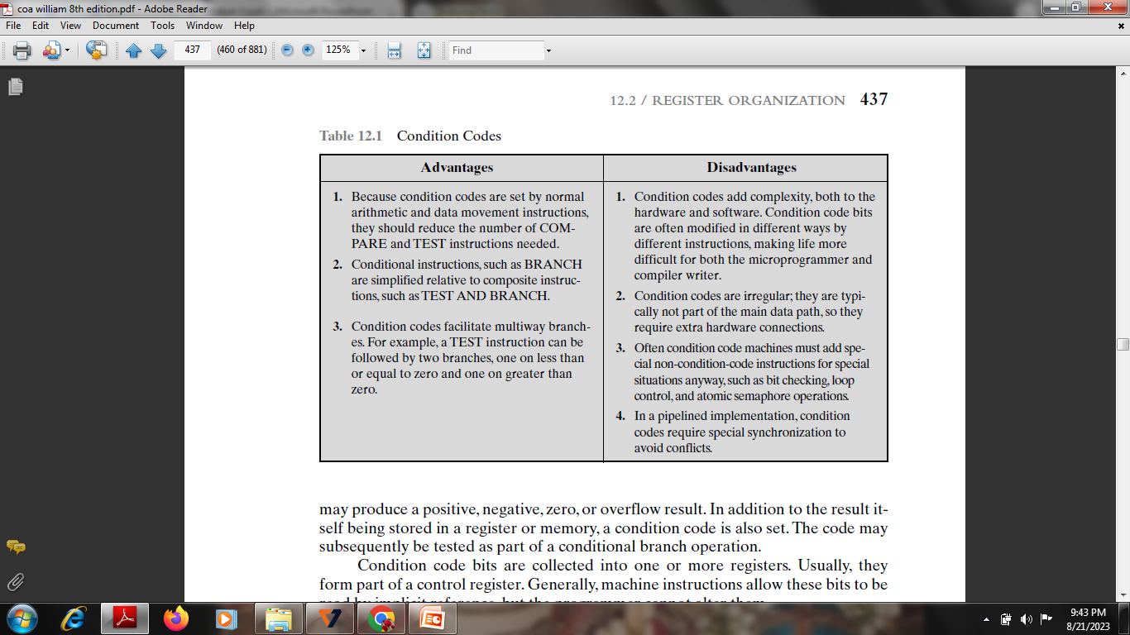

Slide 19
Control & Status Registers
Program Counter (PC)-Contains the address of an instruction to be fetched
Instruction Decoding Register(IR)-Contains the instruction most recently fetched
Memory Address Register(MAR)-Contains the address of a location in memory
Memory Buffer Register(MBR)-Contains a word of data to be written to memory or the word most recently read
movement of data between the processor and memory
Within the processor, data must be presented to the ALU for processing.
The ALU may have direct access to the MBR and user-visible registers

Slide 20
Memory Address Register (MAR)
Connected to address bus
Specifies address for read or write op
Memory Buffer Register (MBR)
Connected to data bus
Holds data to write or last data read
Program Counter (PC)
Holds address of next instruction to be fetched
Instruction Register (IR)
Holds last instruction fetched/current instruction being executed

Slide 21
Program Status Word
program status word (PSW) contain status information.
The PSW typically contains condition codes plus other status information. Common fields or flags include the following:
A set of bits
Includes Condition Codes
Sign of last result
Zero-set when result is 0
Carry
Equal
Overflow
Interrupt enable/disable-enable or disable interrupts.
Supervisor-Indicates whether the processor is executing in supervisor or user mode.

Slide 22
The user state is the default (normal) state of operation, in which user programs are executed.
The supervisor state is a special mode of operation to which the user has no access.
When it is in the supervisor state, the processor and its actions are entirely controlled by the Operating System (OS).

Slide 23
Processor operations mostly involve processing data.
This data can be stored in memory and accessed from thereon.
However, reading data from and storing data into memory slows down the processor
To speed up the processor operations, the processor includes some internal memory storage locations, called registers.
The registers store data elements for processing without having to access the memory. A limited number of registers are built into the processor chip.
The registers are grouped into three categories −
General registers,
Control registers, and
Segment registers.
The general registers are further divided into the following groups −
Data registers,
Pointer registers, and
Index registers.

Slide 24
General Registers
AX is the primary accumulator; it is used in input/output and most arithmetic instructions. For example, in multiplication operation, one operand is stored in EAX or AX or AL register according to the size of the operand.
BX is known as the base register, as it could be used in indexed addressing (the content of a given index register gets added to an instruction's address part so as to obtain the effective address.).
CX is known as the count register, as the ECX, CX registers store the loop count in iterative operations.
DX is known as the data register. It is also used in input/output operations. It is also used with AX register along with DX for multiply and divide operations involving large values.

Slide 25
Pointer Registers
Instruction Pointer (IP) − The 16-bit IP register stores the offset address (The offset address, which is a part of the address, is added to the start of the segment to ad­dress a memory location within the memory segment) of the next instruction to be executed. IP in association with the CS register (as CS:IP) gives the complete address of the current instruction in the code segment.
Stack Pointer (SP) − The 16-bit SP register provides the offset value within the program stack. SP in association with the SS register (SS:SP) refers to be current position of data or address within the program stack.
The stack is a block of memory that may be used for temporarily storing the contents of registers inside CPU. • Stack is accessed by using SP and SS

Slide 26
Base Pointer (BP) − The 16-bit BP register mainly helps in referencing the parameter variables passed to a subroutine.
It is primarily used in accessing parameters passed by the stack .
The address in SS (Stack) register is combined with the offset in BP to get the location of the parameter.
BP can also be combined with DI (Destination index-16 bit register) and SI (Source index-16 bit register) as base register for special addressing.

Slide 27
Index Registers
SI and DI, are used for indexed addressing and sometimes used in
addition and subtraction.
There are two sets of index pointers −
Source Index (SI) − It is used as source index for string operations. It is used in the pointer addressing of data and as a source in some string-related operations
Destination Index (DI) − It is used as destination index for string operations. It is used in the pointer addressing of data and as a destination in some string-related operations.

Slide 28
Control Registers
The 32-bit instruction pointer register and the 32-bit flags register combined are considered as the control registers.
Many instructions involve comparisons and mathematical calculations and change the status of the flags and some other conditional instructions test the value of these status flags to take the control flow to other location.
Flags-Condition of the microprocessor and control its operation
The common flag bits are:

Slide 29
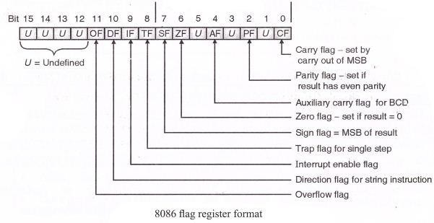
FLAG REGISTER 8086

Slide 30
Overflow Flag (OF) − It indicates the overflow of a high-order bit
(leftmost bit) of data after a signed arithmetic operation.
Direction Flag (DF) − It determines left or right direction for moving or comparing string data. When the DF value is 0, the string operation takes left-to-right direction and when the value is set to 1, the string operation takes right-to-left direction.

Slide 31
Trap Flag (TF) − It allows setting the operation of the processor in single-step mode.
The DEBUG program we used sets the trap flag, so we could step through the execution one instruction at a time.
Sign Flag (SF) − It shows the sign of the result of an arithmetic operation. This flag is set according to the sign of a data item following the arithmetic operation. The sign is indicated by the high-order of leftmost bit. A positive result clears the value of SF to 0 and negative result sets it to 1.
Zero Flag (ZF) − It indicates the result of an arithmetic or comparison operation. A
nonzero result clears the zero flag to 0, and a zero result sets it to 1.

Slide 32
Interrupt Flag (IF) − It determines whether the external interrupts like keyboard entry, etc., are to be ignored or processed. It disables the external interrupt when the value is 0 and enables interrupts when set to 1.

Slide 33
Auxiliary Carry Flag (AF) − It contains the carry from bit 3 to bit 4 following an arithmetic operation; used for specialized arithmetic. The AF is set when a 1- byte arithmetic operation causes a carry from bit 3 into bit 4.
Parity Flag (PF) − It indicates the total number of 1-bits in the result obtained from an arithmetic operation. An even number of 1-bits clears the parity flag to 0 and an odd number of 1-bits sets the parity flag to 1.
Carry Flag (CF) − It contains the carry of 0 or 1 from a high-order bit (leftmost) after an arithmetic operation. It also stores the contents of last bit of
a shift or rotate operation.

Slide 34
Segment Registers
Segments are specific areas defined in a program for containing data, code and
stack. There are three main segments −
Code Segment − It contains all the instructions to be executed. A 16-bit Code
Segment register or CS register stores the starting address of the code segment.
Data Segment(DS,ES) − It contains data, constants and work areas. A 16-bit Data
Segment register or DS register stores the starting address of the data segment.
Stack Segment − It contains data and return addresses of procedures or subroutines. It is implemented as a 'stack' data structure. The Stack Segment register or SS register stores the starting address of the stack.

Slide 35
INSTRUCTION FORMAT
(PENTIUM)
An instruction format defines the layout of the bits of an instruction, in terms of its constituent fields
Opcodes-Operation Code
Operands-Data
→Instruction=Opcodes+Operands.
Instruction :- MOV A (Destination),B(Source)
Examples:
MOV AX,BX Add AX,4 JMP
MUL 3,5

Slide 36
Instruction Formats
Layout of bits in an instruction
Includes opcode
Includes (implicit or explicit) operand(s)
Usually more than one instruction format in an instruction set

Slide 37
Instruction Length
Affected by and affects:
Memory size
Memory organization
Bus structure
CPU complexity
CPU speed
User wants more opcodes, operands (greater flexibility in implementing certain functions), addressing modes , address range
All of these things (opcodes, operands, addressing
modes, address range) require bits and push in the direction of longer instruction length-more space
.

Slide 38
Allocation of Bits
Number of addressing modes-
Number of operands
Register versus memory-A machine must have registers so that data can be brought into the processor for processing. The more that registers can be used for operand references, the fewer bits are needed
Number of register sets-Some architectures, including that of the x86, have a collection of two or more specialized sets (data & addressing). a functional split requires fewer bits to be used in the instruction.

Slide 39
Address range-the range of addresses that can be referenced is related to the number of address bits. it is still convenient to allow rather large displacements from the register address, which requires a relatively large number of address bits in the instruction.
Address Granularity-In a system with 16- or 32-bit words, an address can reference a word or a byte at the designer’s choice. Byte addressing is convenient for character manipulation but requires, for a fixed size memory, more address bits.

Slide 40
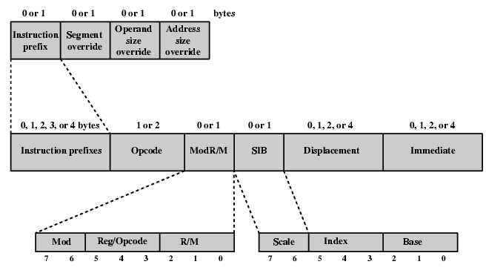
Pentium Instruction Format

Slide 41
Instructions are made up of from zero to four optional instruction prefixes, a 1- or 2-byte opcode, an optional address specifier (which consists of the ModR/m byte and the Scale Index byte) an optional displacement, and an optional immediate field.
Instruction Prefixes-LOCK prefix (ensure the use of shared memory in multiprocessor environments.) or one of the REPEAT prefixes(REP,REPE,REPNE,REPZ,REPNZ…. specify repeated operation of a string, which enables the x86 to process strings much faster)
Segment Override-explicitly specifies which segment register an instruction should use

Slide 42
PENTIUM INSTRUCTION FORMAT
Address Size-16 or 32 bit (switch)-either 16- or 32-bit addresses. The address size determines the displacement size in instructions and the size of address offsets generated during effective address calculation. address size prefix switches between 32-bit and 16-bit address generation.
Operand Size-16 or 32 bit (switch)-An instruction has a default operand size of 16 or 32 bits, and the operand prefix switches between 32-bit and 16-bit operands.

Slide 43
PENTIUM INSTRUCTION FORMAT
Opcode- 1, 2, or 3 bytes in length. It include bits that specify if data is byte- or full-size, direction of data operation (to or from memory), and whether an immediate data field must be sign extended.
Mod R/m-addressing information
-specifies whether an operand is in a register or in memory; if it is in memory, then fields within the byte specify the addressing mode to be used
-consists of three fields: The Mod field (2 bits) combines with the r/m field to form 32 possible values: 8 registers and 24 indexing modes;
-The Reg/Opcode field (3 bits) specifies either a register number or three more bits of opcode information;
-the r/m field (3 bits) can specify a register as the location of an operand, or it can form part of the addressing

Slide 44
Mod+ r/m (combined info of registers and addressing modes)
Register-register or opcode info
SIB-specify fully the addressing mode
Scale (2 bits)-scale factor for scaled indexing
Index (3 bits)-specifies index register(SI,DI)
Base (3 bits)-specifies base register(BX)
Displacement-When the addressing-mode specifier indicates that a displacement is used, an 8-, 16-, or 32-bit signed integer displacement field is added.
Immediate-provides the value of 8/16/32 bit operand

Slide 45
William Stallings Computer Organization and Architecture
6th Edition
Chapter 11 Instruction Sets:
Addressing Modes and Formats

Slide 46
Addressing modes
The way for which an operand is specified for an instruction in the accumulator, in a general purpose register or in memory location, is called addressing mode.
Different opcodes will use different addressing modes.
one or more bits in the instruction format can be used as a mode field. The value of the mode field determines which addressing mode is to be used.
In a system without virtual memory, the effective address will be either a main memory address or a register. In a virtual memory system, the effective address is a virtual address or a register

Slide 47
Addressing Modes
Immediate
Direct
Indirect
Register
Register Indirect
Displacement (Indexed)
Stack
35

Slide 48
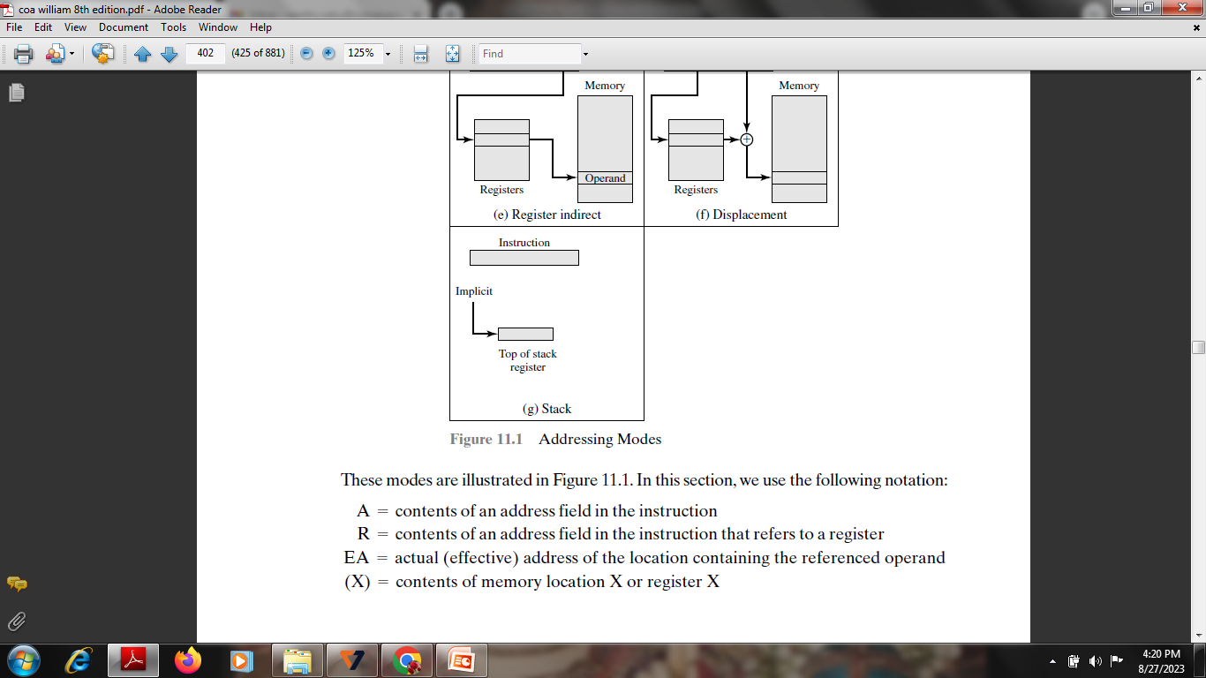

Slide 49
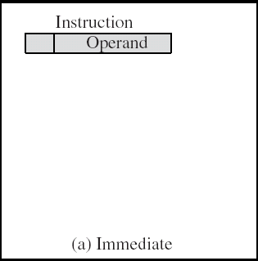
Immediate Addressing
In this mode data is present in address field of instruction .
Designed like one address instruction format
Note:Limitation in the immediate mode is that the range of constants are restricted by size of address field.
FEATURES
Operand is part of instruction
Operand = address field
No memory reference to fetch data-saving memory
Fast
Limited range-size of the number is restricted to the size of the address field
36

Slide 50
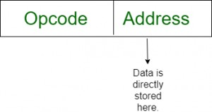
MOV AX, 2000
MOV CL, 0A
ADD AL, 45
ADD AX, 0000
MOV CX, 4929 H (source operand-16 bit-part of instruction)
ADD AX, 2387 H,
MOV AL, FFH (15 bit data)
37

Slide 51
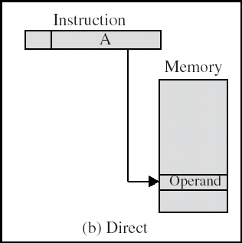
Direct(M) Addressing Diagram

Slide 52
Direct Addressing
Address field contains address of operand
EFFECTIVE ADDRESS EA = address field (A)
– Look in memory at address value for operand
Single memory reference to access data
No additional calculations to work out effective address
Limited address space

Slide 53
Address of the memory location is given directly
The operand’s offset is given in the instruction as an 8 bit or
16 bit displacement element.
In this addressing mode the 16 bit effective address of the
data is the part of the instruction.
Here only one memory reference operation is required to access the data.

Slide 54

MOV AX, [0500] ADD AL,[0301]

Slide 55
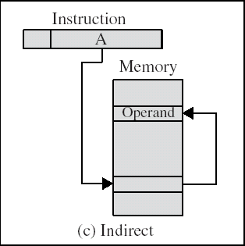
Indirect Addressing Diagram

Slide 56
In this mode address field of instruction contains the address
of effective address.
Here two
1st reference
references
to get
are
required.
effective
address.
2nd reference to access the data.
.

Slide 57
Indirect Addressing (1/2)
Memory cell pointed to by address field contains the address
of (pointer to) the operand
EA =(A)
Look in A, find address (A) and look there for operand
e.g. ADD AX, (A)
Add contents of cell pointed to by contents of A to accumulator

Slide 58
Indirect Addressing (2/2)
Large address space
2^{n} where n = word length
May be nested, multilevel, cascaded
– e.g. EA = (((A)))
Draw the diagram yourself
Multiple memory accesses to find operand
Hence slower

Slide 59
Based on the availability of Effective address, Indirect mode is of two kind:
REGISTER INDIRECT: In this mode effective
address is in the register, and corresponding register name will be maintained in the address field of an instruction.
– Here one register reference,one memory reference is required to access
44
the data.

Slide 60
MEMORY INDIRECT: In this mode effective
address is in the memory, and corresponding memory address will be maintained in the address field of an instruction.
– Here two memory reference is required to access the data

Slide 61
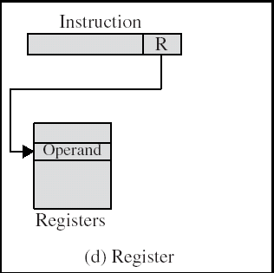
Register Addressing Diagram

Slide 62

In register addressing the operand is placed in one of 8 bit or
16 bit general purpose registers.
The data is in the register that is specified by the instruction.
– Here one register reference is required to access the data.

Slide 63
Register Addressing (1/2)
Operand is held in register named in address filed
EA = R
Limited number of registers
Very small address field needed
Shorter instructions
Faster instruction fetch
MOV AX, BX
ADD AX, BX

Slide 64
Register Addressing (2/2)
No memory access
Very fast execution
Very limited address space
Multiple registers helps performance
Requires good assembly programming or compiler writing
Similar to Direct addressing

Slide 65
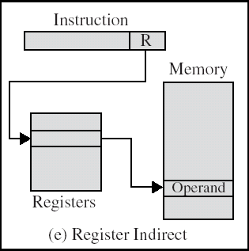
Register Indirect Addressing Diagram

Slide 66

In this addressing the operand’s offset is placed in any one of
the registers BX,BP,SI,DI as specified in the instruction.
The effective address of the data is in the base register or an index register that is specified by the instruction.
– Here two register reference is required to access the data.

Slide 67
Register Indirect Addressing
MOV AX, [BX]
(move the contents of memory location s addressed by the register BX to the register AX)
MOV AX, [DI] ADD AL, [BX]
MOV AX, [SI]
Operand is in memory cell pointed to by contents of register R
Large address space (2^{n})
One fewer memory access than indirect addressing

Slide 68
the address space limitation (limited range of addresses) of the address field is overcome by having that field refer to a wordlength location containing an address.
In addition, register indirect addressing uses one less memory reference than indirect addressing.

Slide 69
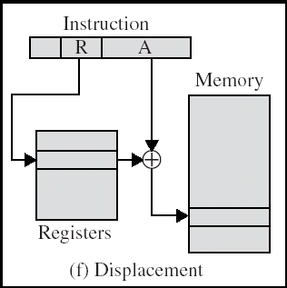
Displacement Addressing Diagram

Slide 70
Displacement Addressing
Combination of direct and register indirect
EA = A + (R)
Effective address=start address + displacement
Effective address=Offset + (Segment Register)
Address field hold two values
A = base value
R = register that holds displacement
or vice versa

Slide 71
The value contained in one address field is used directly. (A)
The other address field, or an implicit reference based on opcode, refers to a register whose contents are added to A to produce the effective address.
EA = A + (R)

Slide 72
three of the most common uses of displacement addressing:
Relative addressing
Base-register addressing
Indexing

Slide 73
Relative addressing
PC-relative addressing,
the implicitly referenced register is the program counter (PC).
That is, the next instruction address is added to the address field to produce the EA.

Slide 74
Base-Register Addressing
Base register addressing mode is used to implement inter segment transfer of control.
The referenced register contains a main memory address, and the address field contains a displacement
In this mode effective address is obtained by adding base register value to address field value.
EA= Base register + Address field value.

Slide 75
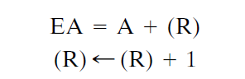
Indexed Addressing
The address field references a main memory address, and the referenced register contains a positive displacement from that address.
The operand’s offset is the sum of the content of an index register SI or DI and an 8 bit or 16 bit displacement.
MOV AX, [SI +05]
efficient mechanism for performing iterative operations
Autoindexing-typical INC/DEC

Slide 76
Stack Addressing
stack is a linear array of locations. It is sometimes referred to as a pushdown list or last-in-first-out queue
stack pointer whose value is the address of the top of the stack.
form of implied addressing () instructions that comprise only an opcode without an operand
Operand is (implicitly) on top of stack
e.g.
– ADD Pop top two items from stack and add and push
-PUSH AX
POP AX
59

Slide 77
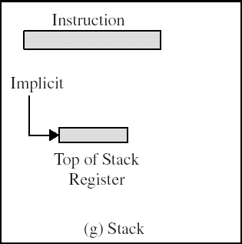
No memory reference

Slide 78
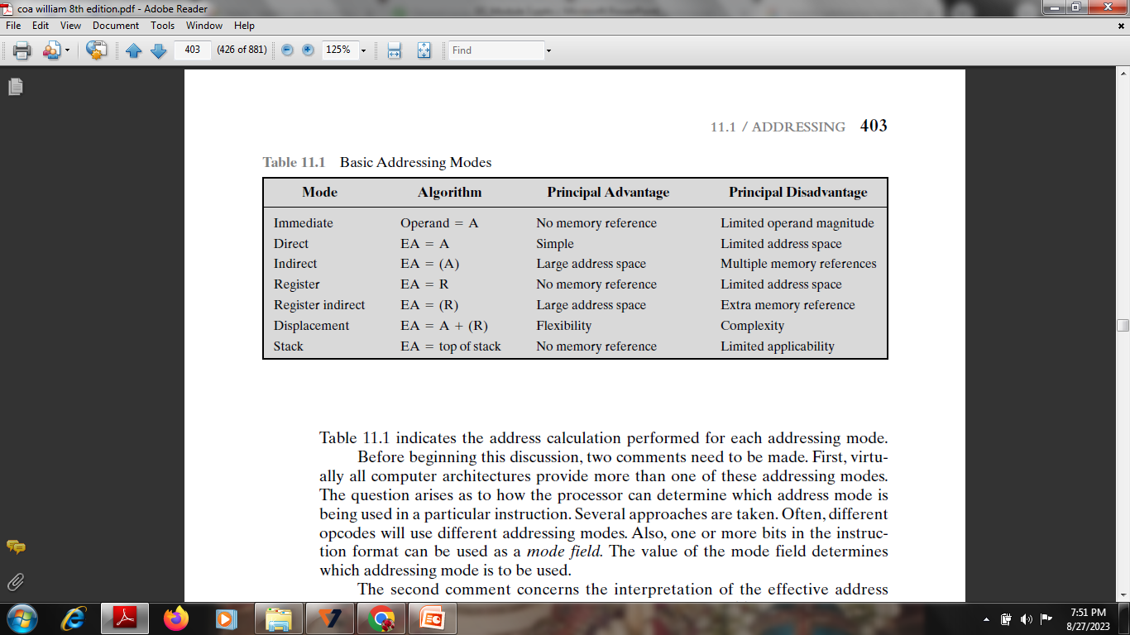

Slide 79
Instruction Cycle

Slide 80
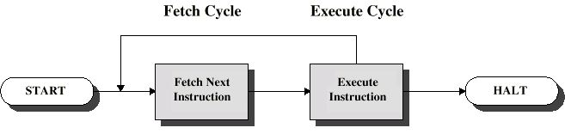
Instruction Cycle
The processor reads ( fetches) instructions from memory one at a time and executes each instruction.
Program execution consists of repeating the
process of instruction fetch and instruction execution
Two steps:
Fetch
Execute
The processing required for a single instruction is called an instruction cycle

Slide 81
At the beginning of each instruction cycle the processor fetches an instruction from memory.
Program counter (PC) -holds the address of the instruction to be fetched next
The fetched instruction is loaded into a register in the processor known as the instruction register (IR).
The instruction contains bits that specify the action the processor is to take.
The processor interprets the instruction and performs the required action

Slide 82
Instruction Cycle
It is the time in which a single instruction is fetched from memory, decoded, and executed
An Instruction Cycle requires the following subcycle:
FETCH
EXECUTE
INDIRECT
INTERRUPT

Slide 83
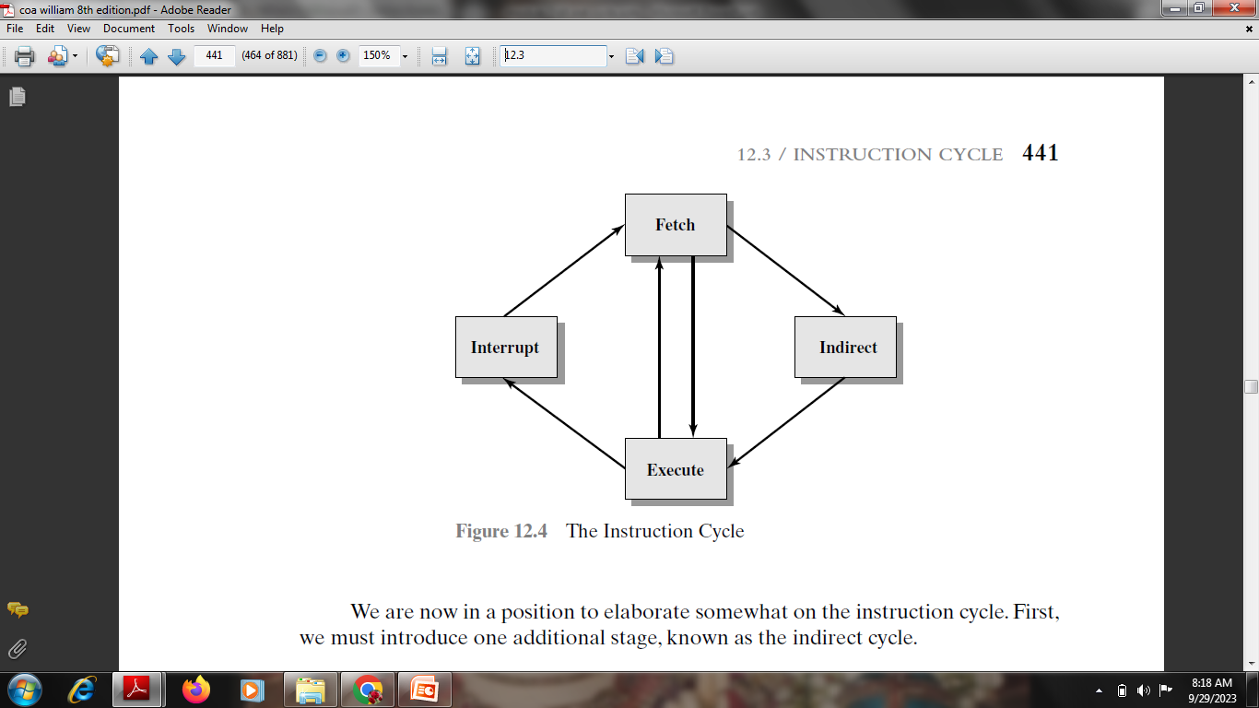

Slide 84
Instruction Cycle
Fetch
Read next instruction from memory into the processor
Indirect Cycle (Decode Cycle)
May require memory access to fetch operands, therefore more memory accesses.
Interrupt
Save current instruction and service the interrupt
Execute
Interpret the opcode and perform the indicated operation

Slide 85
all computers provide a mechanism by which other modules (I/O, memory) may interrupt the normal processing of the processor
To accommodate interrupts, an interrupt cycle is added to the instruction cycle
In the interrupt cycle, the processor checks to see if any interrupts have occurred, indicated by the presence of an interrupt signal.
If no interrupts are pending, the processor proceeds to the fetch cycle and fetches the next instruction of the current program

Slide 86
If an interrupt is pending, the processor does the following:
It suspends execution of the current program being executed and saves its context. This means saving the address of the next instruction to be executed
It sets the program counter to the starting address of an interrupt handler routine.
The processor now proceeds to the fetch cycle and fetches the first instruction in the interrupt handler program, which will service the interrupt
When the interrupt handler routine is completed, the processor can resume execution of the user program at the point of interruption.

Slide 87
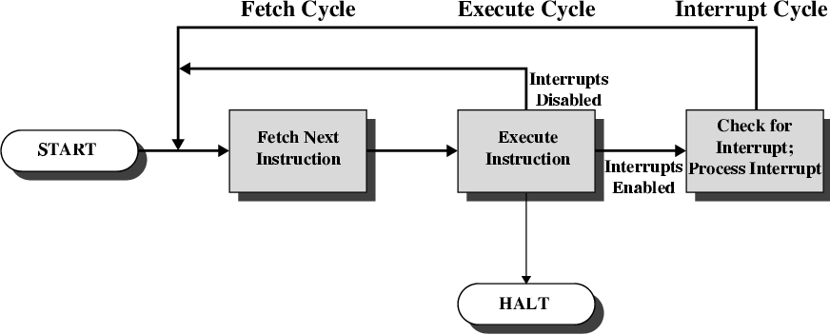
Instruction Cycle with Interrupts

Slide 88
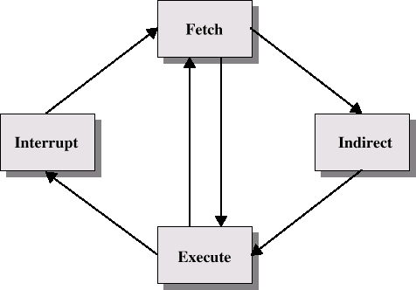
Instruction Cycle
Fetch
Execute
Fetch
Fetch
Fetch
Interrupt
Indirect
Interrupt
Indirect
Execute
Execute
Execute

Slide 89
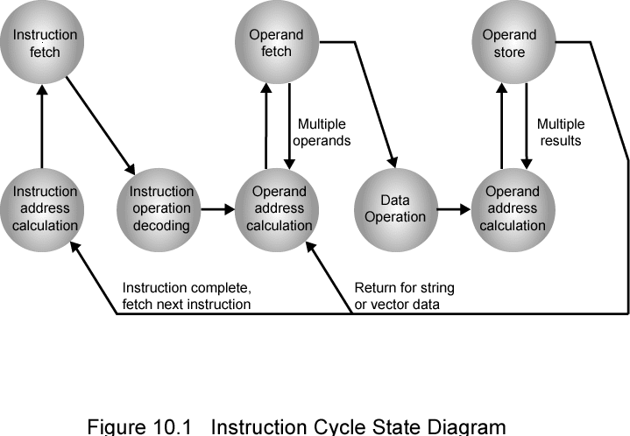
Instruction Cycle State Diagram

Slide 90
Instruction Cycle State Diagram
This illustrates more correctly the nature of the instruction cycle.
Once an instruction is fetched, its operand specifiers must be identified.
Each input operand in memory is then fetched, and this process may require indirect addressing.
Register-based operands need not be fetched.
Once the opcode is executed, a similar process may be needed to store the result in main memory.

Slide 91
Instruction address calculation (iac): Determine the address of the next instruction to be executed
Instruction fetch (if): Read instruction from its memory location into the processor.
Instruction operation decoding (iod): Analyze instruction to determine type of operation to be performed and operand(s) to be used.
Operand address calculation (oac): If the operation involves reference to an operand in memory or available via I/O, then determine the address of the operand
Operand fetch (of): Fetch the operand from memory or read it in from I/O.
Data operation (do): Perform the operation indicated in the instruction.
Operand store (os): Write the result into memory or out to I/O.

Slide 92
Each instruction is executed during an instruction cycle made up of shorter subcycles (e.g., fetch, indirect, execute, interrupt).
The execution of each subcycle involves one or more shorter operations, that is, micro- operations.
Micro-operations are the functional, or atomic, operations of a processor

Slide 93
Fetch Cycle-Registers
Memory Address Register (MAR)
Connected to address bus
Specifies address for read or write op
Memory Buffer Register (MBR)
Connected to data bus
Holds data to write or last data read
Program Counter (PC)
Holds address of next instruction to be fetched
Instruction Register (IR)
Holds last instruction fetched/current instruction being executed

Slide 94
Fetch Cycle
Program Counter (PC) holds address of next instruction to be
fetched
Processor fetches instruction from memory location pointed to by PC
Increment PC
– Unless told otherwise
Instruction loaded into Instruction Register (IR)
Processor interprets instruction and performs required actions

Slide 95
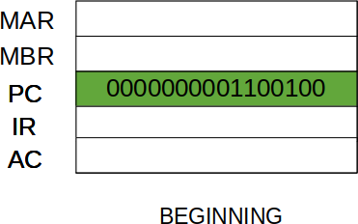
The Fetch Cycle –
-At the beginning of the fetch cycle, the address of the next instruction to be executed is in the Program Counter(PC).
-address is 1100100

Slide 96
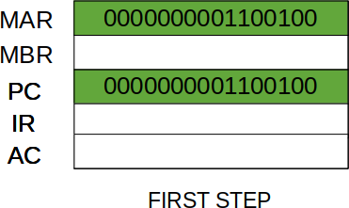
Step 1:
The address in the program counter is moved to the memory address register(MAR), as this is the only register which is connected to address lines of the system bus.

Slide 97
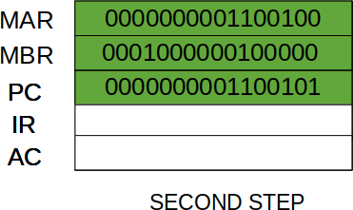
Step 2:
The address in MAR is placed on the address bus, now the control unit issues a READ command on the control bus, and the result appears on the data bus and is then copied into the memory buffer register(MBR).
Program counter is incremented by one, to get ready for the next instruction.(These two action can be performed simultaneously to save time)

Slide 98
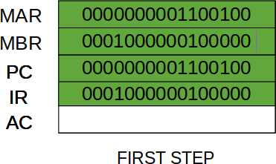
Step 3:
The content of the MBR is moved to the instruction register(IR)
THIRD STEP

Slide 99
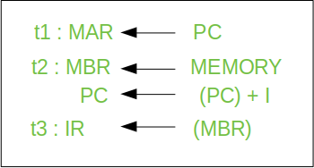
Fetch Sequence (symbolic)
three steps and four micro-operations
Each micro-operation involves the movement of data into or out of a register-no interference-saves time
(t1, t2, t3) represents successive time units
I –instruction length

Slide 100
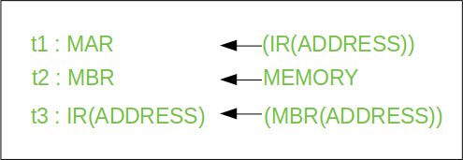
Indirect Cycle-fetch source operands

Slide 101
Step 1:
The address field of the instruction is transferred to the MAR.
This is used to fetch the address of the operand.
Step 2:
The address field of the IR is updated from the MBR.(So that it now contains a direct addressing rather than indirect addressing)
Step 3:
The IR is now in the state, as if indirect addressing has not been
occurred.

Slide 102
Interrupt Cycle
At the completion of the Execute Cycle, a test is made to
determine whether any enabled interrupt has occurred or not.
If an enabled interrupt has occurred then Interrupt Cycle occurs.
The nature of this cycle varies greatly from one machine to
another.

Slide 103
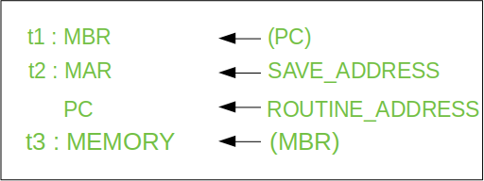

Slide 104
Step 1: Contents of the PC is transferred to the MBR, so that they can be saved for return.
Step 2: MAR is loaded with the address at which the contents of the PC are to be saved.
PC is loaded with the address of the start of the interrupt- processing routine.
Step 3: MBR, containing the old value of PC, is stored in memory.
– Note: In step 2, two actions are implemented as one micro-operation. However, most processor provide multiple types of interrupts, it may take one or more micro- operation to obtain the save_address and the routine_address before they are transferred to the MAR and PC respectively.

Slide 105
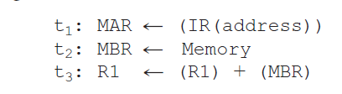
Execute Cycle (ADD)
Different for each instruction
The control unit examines the opcode and generates a sequence of micro-operations based on the value of the opcode- Instruction decoding.
e.g. ADD R1,X - add the contents of location X to Register 1 , result in R1
IR contains the ADD instruction.
In the first step, the address portion of the IR is loaded into the MAR.
Then the referenced memory location is read.
Finally, the contents of R1 and MBR are added by the ALU

Slide 106
Micro-Operations
Execution of a program consists of the sequential execution of instructions.
Each instruction is executed during an instruction cycle made up of shorter subcycles (e.g., fetch, indirect, execute, interrupt).
The execution of each subcycle involves one or more shorter operations, that is, micro-operations.
A computer executes a program
Each step does very little
Atomic operation of CPU

Slide 107
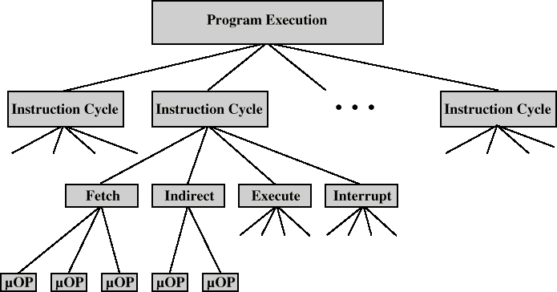
Constituent Elements of Program Execution

Slide 108
Categories of Micro-operation
Transfer data between registers
Transfer data from register to external interface
Transfer data from external to register
Perform arithmetic or logical ops

Slide 109
William Stallings Computer Organization and Architecture
8th Edition
Chapter 15
Control Unit Operation

Slide 110
we have decomposed the behavior or functioning of the processor into elementary operations, called micro-operations.
By reducing the operation of the processor to its most fundamental level, we are able to define exactly what it is that the control unit must cause to happen
definition of these functional requirements is the basis for the design and implementation of the control unit.

Slide 111
Functional Requirements(of Control Unit)
Define basic elements of processor
Describe micro-operations processor performs
Determine functions control unit must perform

Slide 112
Registers
Memory Address Register (MAR)
Connected to address bus
Specifies address for read or write op
Memory Buffer Register (MBR)
Connected to data bus
Holds data to write or last data read
Program Counter (PC)
Holds address of next instruction to be fetched
Instruction Register (IR)
Holds last instruction fetched/current instruction being executed

Slide 113
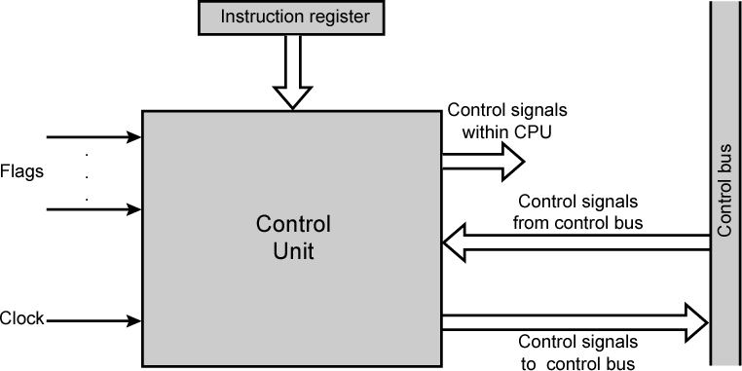
Model of Control Unit

Slide 114
Functions of Control Unit
Sequencing
Causing the CPU to step through a series of micro-operations
Execution
Causing the performance of each micro-op
This is done using Control Signals→→

Slide 115
For the control unit to perform its function, it must have inputs that allow it to determine the state of the system and outputs that allow it to control the behavior of the system.
These are the external specifications of the control unit.
Internally, the control unit must have the logic required to perform its sequencing and execution functions

Slide 116
The inputs are:
Clock: This is how the control unit “keeps time.” It causes one micro-operation to be performed for each clock pulse (processor cycle time/clock cycle time)
Instruction register: The opcode and addressing mode of the current instruction are used to determine which micro-operations to perform during the execute cycle.
Flags: needed by the control unit to determine the status of the processor and the outcome of previous ALU operations
Control signals from control bus: The control bus portion of the system bus provides signals to the control unit

Slide 117
The outputs are as follows:
Control signals within the processor: two types: those that cause data to be moved from one register to another, and those that activate specific ALU functions.
Control signals to control bus: two types: control signals to memory, and control signals to the I/O modules.
Three types of control signals are used:
those that activate an ALU function,
those that activate a data path, and
those that are signals on the external system bus or other external interface.
All of these signals are ultimately applied directly as binary inputs to individual logic gates

Slide 118
Control Signals( input )
Clock
One micro-instruction (or set of parallel micro- instructions) per clock cycle
Instruction register
Op-code for current instruction
Determines which micro-instructions are performed
Flags
State of CPU
Results of previous operations
From control bus
Interrupts
Acknowledgements

Slide 119
Control Signals - output
Within CPU
Cause data movement
Activate specific functions
Via control bus
To memory
To I/O modules

Slide 120
Control Unit Implementation
Hardwired implementation -the control unit is essentially a state machine circuit.
Its input logic signals are transformed into a set of output logic signals, which are the control signals
Microprogrammed implementation- uses sequences of instructions to perform control operations performed by micro operations called microprogramming/firmware

Slide 121
Control Unit Organization- How can we use the concept of microprogramming to implement a control unit?

Slide 122
Micro-programmed Control William Stallings Computer Organization and Architecture
8th Edition
Chapter 16

Slide 123
Microprogramming language-each line describes a set of micro-operations occurring at one time and is known as a microinstruction.
A sequence of instructions is known as a microprogram, or firmware.

Slide 124
Implementation
For each micro-operation, the control unit does is generate a set of control signals
Each control signal is on or off
Represent each control signal by a bit for each control line
Construct a control word for each micro-operation
Have a sequence of control words for each machine code instruction
Add an address to specify the next micro-instruction, depending on conditions

Slide 125
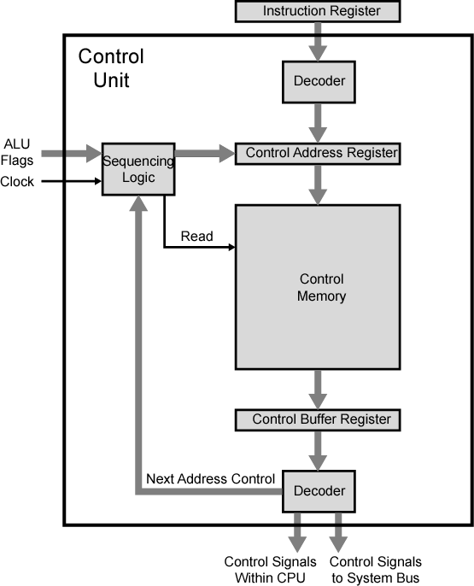
Functioning of Micro programmed
Control Unit

Slide 126
The control memory contains a program that describes the behavior of the control unit.
The set of microinstructions is stored in the control memory.
The control address register contains the address of the next microinstruction to be read.
When a microinstruction is read from the control memory, it is transferred to a control buffer register.
reading a microinstruction from the control memory is the same as executing that microinstruction.
sequencing unit -loads the control address register and issues a read command.
control unit still has the same inputs (IR,ALU, flags, clock) and outputs (control signals)

Slide 127
Micro programmed Control Unit Functions
Sequence logic unit issues read command
Word specified in control address register is read into control buffer register
Control buffer register contents generates control signals and next address information
Sequence logic loads new address into control buffer register based on next address information from control buffer register and ALU flags

Slide 128
Next Address Decision
Depending on ALU flags and control buffer register
Get next instruction
Add 1 to control address register
Jump to new routine based on jump microinstruction
Load address field of control buffer register into control address register
Jump to machine instruction routine
Load control address register based on opcode in IR

Slide 129
The upper decoder translates the opcode of the IR into a control memory address.
The lower decoder is not used for horizontal microinstructions but is used for vertical microinstructions

Slide 130
Advantages and Disadvantages of Microprogramming
Simplifies design of control unit
Cheaper
Less error-prone
Slower

Slide 131
Tasks Done By Microprogrammed Control Unit
Microinstruction sequencing-Get the next microinstruction from the control memory.
Microinstruction execution-Generate the control signals needed to execute the microinstruction.
Must consider both together-to design control unit affect the format of the microinstruction and the timing of the control unit

Slide 132
Micro Instruction Sequencing-Design Considerations
Microinstruction sequencing technique-the size of the microinstruction time-(reduces the cost of that component) and the address-generation (to execute microinstructions as fast as possible)
In executing a microprogram, the address of the next microinstruction to be executed is in one of these categories:
Determined by instruction register
Next sequential address
Branch

Slide 133
Sequencing Techniques
Based on the current microinstruction, condition flags, and the contents of the instruction register, a control memory address must be generated for the next microinstruction
Different techniques are based on the format of the address information in the microinstruction:
Two address fields
Single address field
Variable format

Slide 134
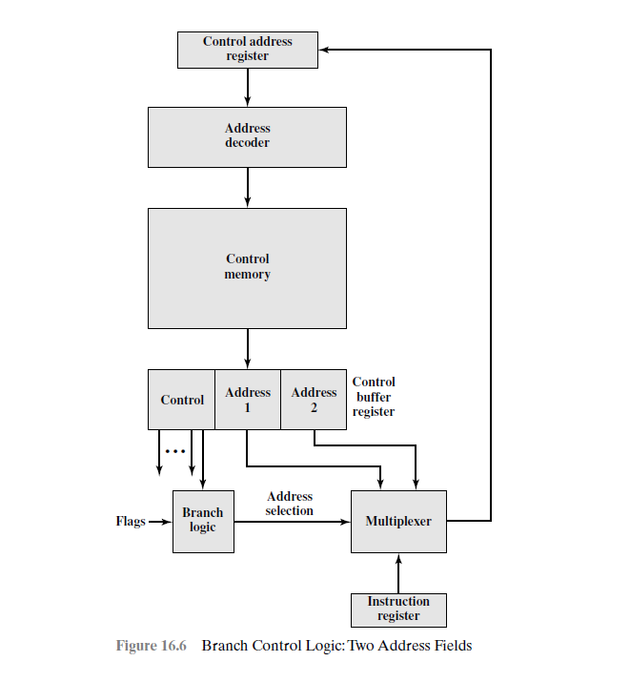
Multiplexer (data selector) is provided that serves as a destination for both address fields plus the instruction register.
Based on an address-selection input, the multiplexer transmits either the opcode or one of the two addresses to the control address register (CAR).
The CAR is subsequently decoded to produce the next microinstruction address.
The address-selection signals are provided by a branch logic module whose input consists of control unit flags plus bits from the control portion of the microinstruction.
Simple and it requires more bits in the microinstruction than other approaches

Slide 135
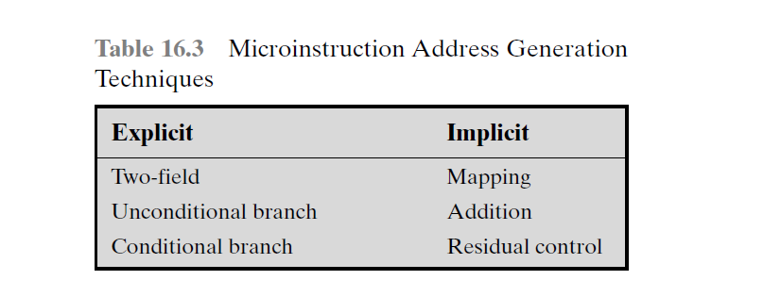
Address Generation
explicit techniques, in which the address is explicitly available in the microinstruction, and implicit techniques, which require additional logic to generate the address.
With a two-field approach, two alternative addresses are available with each microinstruction
A conditional branch instruction depends on the following types of information:
ALU flags
Part of the opcode or address mode fields of the machine instruction
Parts of a selected register, such as the sign bit
Status bits within the control unit

Slide 136
Mapping, is required with virtually all designs-The opcode portion of a machine instruction is mapped into a microinstruction address ( occurs only once per instruction cycle)
Addition-combining or adding two portions of an address to form the complete address.
Residual control-use of a microinstruction address that has previously been saved in temporary storage within the control unit

Slide 137
Microinstruction execution
The control logic module generates control signals as a function of some of the bits in the microinstruction
The execution of a microinstruction is to generate control signals.
Some of these signals control points internal to the processor.
The remaining signals go to the external control bus or other external interface

Slide 138
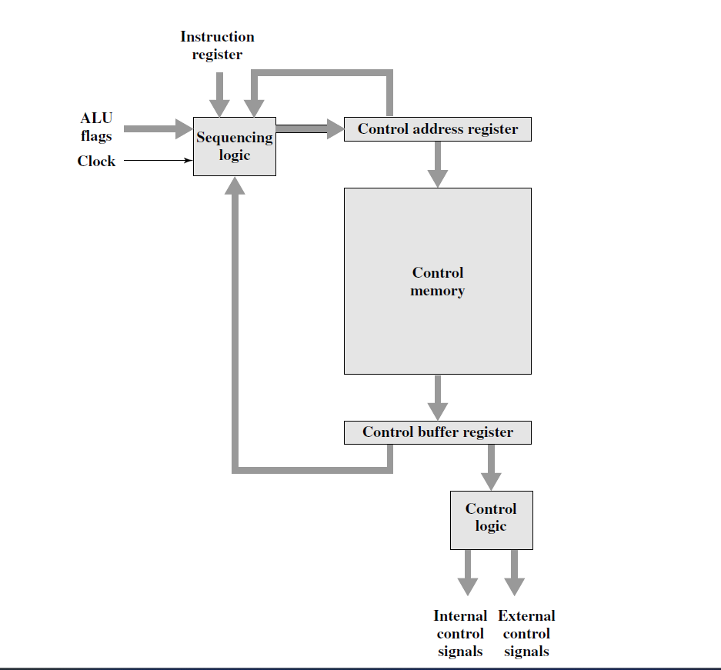
Figure 16.10 Control Unit Organization

Slide 139
Micro-instruction Types
Each micro-instruction specifies many different micro-operations to be performed in parallel
(horizontal micro-programming)
Each micro-instruction specifies single (or few) micro operations to be performed
(vertical micro-programming)

Slide 140
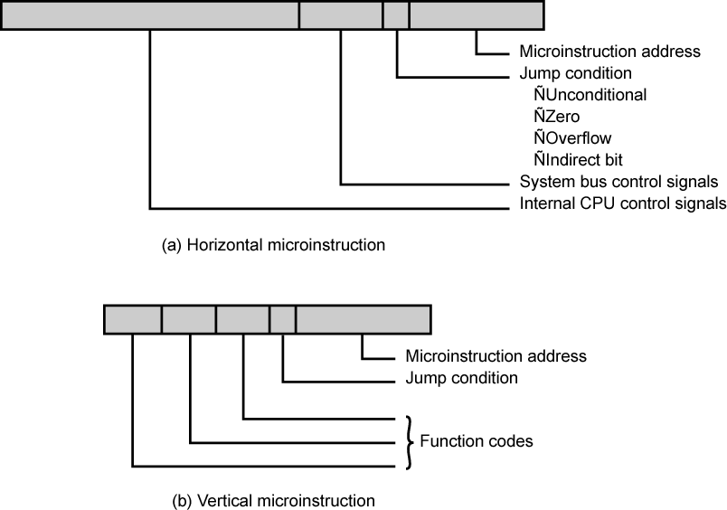
Typical Microinstruction Formats

Slide 141
Horizontal microinstruction
There is one bit for each internal processor control line and one bit for each system bus control line.
There is a condition field indicating the condition under which there should be a branch, and there is a field with the address of the microinstruction to be executed next when a branch is taken
1. To execute this microinstruction, turn on all the control lines indicated by a 1 bit; leave off all control lines indicated by a 0 bit.
The resulting control signals will cause one or more micro-operations to be performed.
2. If the condition indicated by the condition bits is false, execute the next microinstruction in sequence.
3. If the condition indicated by the condition bits is true, the next microinstruction to be executed is indicated in the address field.

Slide 142
Vertical Micro-programming
Width is narrow
Limited ability to express parallelism
Considerable encoding of control information require external memory word decoder to identify the exact control line being manipulated

Slide 143
Horizontal Micro-programming
Wide memory word
High degree of parallel operations possible
Little encoding of control information

Slide 144
Applications of Microprogramming-https://www.geeksforgeeks.org/applications-of-microprogrammed-control-unit/
Microprogramming has many advantages like flexibility, simplicity, cost-effectiveness etc.
Development of control units –making control units of such processors, because it is far less complex and can be easily modified
High level language support –provide support for complex data types directly from the processor level.
Development of special purpose processors –
Improving the operating system
User tailoring of the control unit -As the control Unit is developed using software, it can be easily reprogrammed. This can be used for custom-made modifications of the Control Unit

Slide 145
William Stallings Computer Organization and AChracphtietre1c3ture
7th Edition
Reduced Instruction Set Computers
v/s
Complex Instruction Set Computers

Slide 146
Introduction
The architectural design of the CPU is RISC & CISC.
The CISC architecture helps reduce program code by embedding multiple operations on each program instruction, which makes the CISC processor more complex
RISC has a highly customized set of instructions used in portable devices due to system reliability such as Apple iPod, mobiles/smartphones, Nintendo DS,
Hardware fused with software (Intel v/s Apple)
Intel’s hardware oriented approach is termed as CISC while that of Apple is RISC

Slide 147
Instruction Set Architecture- Interface to allow easy communication between the programmer and the hardware.
ISA- execution of data, copying data, deleting it, editing
Instruction Set , Addressing Modes,

Slide 148
RISC-Reduced Instruction Set Computer
A microprocessor architecture with a simple collection and highly customized set of instructions.
It is built to minimize the instruction execution time by optimizing and limiting the number of instructions.
It means each instruction cycle requires only one clock cycle
RISC processor design has separate digital circuitry in the control unit (produces signals needed for the execution of each instruction in the instruction set of the processor)
Examples of RISC processors:
– IBM RS6000, MC88100
– DEC’s Alpha 21064, 21164 and 21264 processors

Slide 149
CISC-Complex Instruction Set Computer
If the control unit contains a number of micro-electronic circuitry to generate a set of control signals and each micro-circuitry is activated by a micro-code-CISC
The primary goal of CISC architecture is to complete a task in as few lines of assembly code as possible.
Examples of CISC processors are:
– Intel 386, 486, Pentium, Pentium Pro, Pentium II, Pentium III
– Motorola’s 68000, 68020, 68040, etc.

Slide 150
CISC processor features
Instruction set with 120-350 instructions
Variable instruction/data formats
Small set of general purpose registers(8-24)
A large number of addressing modes
High dependency on micro program
Complex instructions to support HLL (High level language) features

Slide 151
CISC processor features
Complex pipelining (decomposing a sequential process into sub-operations, with each sub-operation being executed in a dedicated segment that operates concurrently with all other segments.)
Many functional chips needed to design a computer using CISC
The length of the code is short, so it requires very little RAM.
Difficult to design a superscalar processor ( execution rate in excess of one instruction per machine cycle)

Slide 152
RISC processor features
Instruction set with limited number of instructions
Simple instruction format
Large set of CPU registers
Very few addressing modes
Easy to construct a superscalar processor

Slide 153
RISC processor features
Hardwired control unit for sequencing microinstructions
Supports on chip cache memory
All functional units on a single chip
Simple pipelining

Slide 154
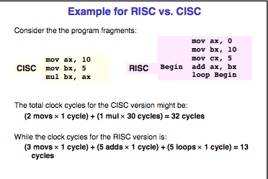

Slide 155
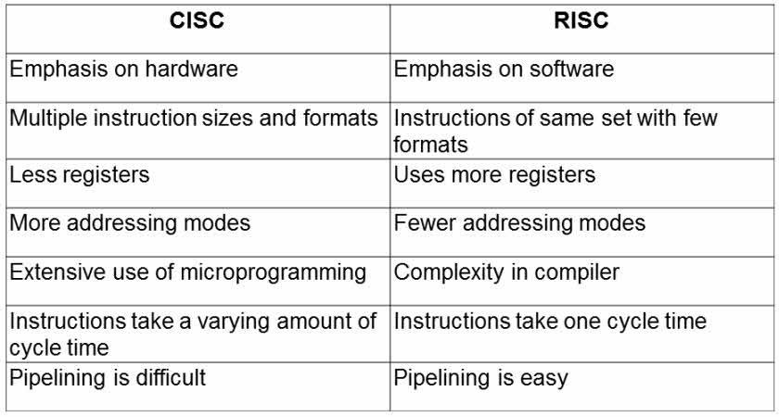

Slide 156
Pipelining
Pipelining is the process of accumulating instruction from the processor through a pipeline.
It allows storing and executing instructions in an orderly process. It is also known as pipeline processing.
Pipelining is a technique where multiple instructions are overlapped during execution.
Pipelining-to simplify hardware by using an instruction set composed of basic steps for evaluating, loading, and storing operations.
the processor works on different steps of the instruction at the same time, more instructions can be executed in a shorter period of time.
they are basically variations of these five, used in the MIPS R3000 processor:
fetch instructions from memory
read registers and decode the instruction
execute the instruction or calculate an address
access an operand in data memory
write the result into a register

Slide 157
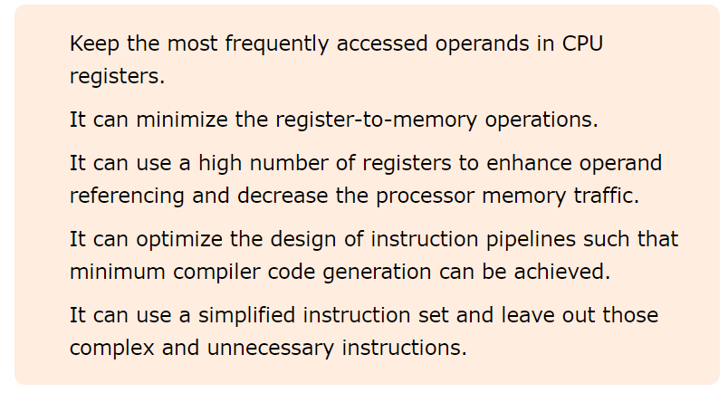
Principles of RISCs Pipeline

Slide 158
the length of the pipeline is dependent on the length of the longest step.
more conducive to pipelining.
While CISC instructions varied in length, RISC instructions are all the same length and can be fetched in a single operation.
https://cs.stanford.edu/people/eroberts/courses/soco/projects/risc/pipelining/index.html

Slide 159
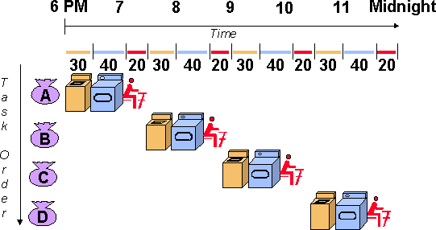
PIPELINING-Ex Laundry Analogy

Slide 160
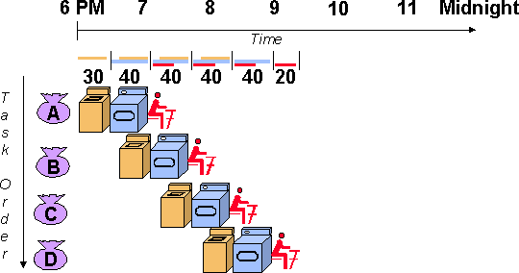

Slide 161
Problems with pipeline
Stalling of pipeline
Data Dependency
Branch,etc…
RISC processors operate at more than one cycle per instruction (practically).
The processor might occasionally stall as a result of data dependencies and branch instructions.
A data dependency occurs when an instruction depends on the results of a previous instruction.
A particular instruction might need data in a register which has not yet been stored since that is the job of a preceding instruction which has not yet reached that step in the pipeline.
Solution-Code reordering-code could be rearranged so that those instructions are executed in between the two dependent instructions and the pipeline could flow efficiently.

Slide 162
Branch instructions are those that tell the processor to make a decision about what the next instruction to be executed should be based on the results of another instruction.
Branch instructions can be troublesome in a pipeline if a branch is conditional on the results of an instruction which has not yet finished its path through the pipeline.
Superpipelining refers to dividing the pipeline into more steps. The more pipe stages there are, the faster the pipeline is because each stage is then shorter.
Ideally, a pipeline with five stages should be five times faster than a non-pipelined processor

Slide 163
RISC Pipelining
Pipelining with Regular Instructions
Most instructions are register to register
Two phases of execution, I E
I: Instruction fetch
E: Execute
Perform ALU operation with register input and output
For load and store(memory),I E D
I: Instruction fetch
E: Execute
Calculate memory address
D: Memory
Register to memory or memory to register operation

Slide 164
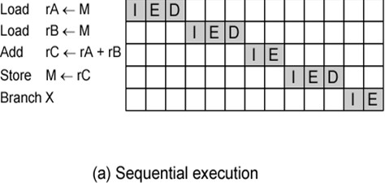
timing of a sequence of instructions using no pipelining-Clearly, this is a wasteful process

Slide 165
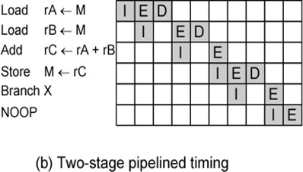
NOP is typically used to generate a delay in execution or to reserve space in code memory.

Slide 166
instruction fetch stage of the second instruction can be performed in parallel with the first part of the execute/memory stage.
a branch instruction interrupts the sequential flow of execution-NOOP- generate a delay in execution or to reserve space in code memory

Slide 167
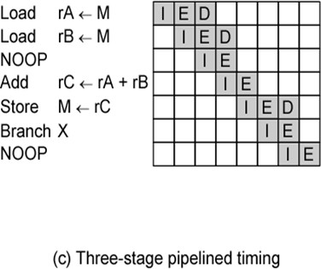
three instructions can be overlapped, and the improvement is as much as a factor of 3

Slide 168
RISC Architecture
9 functional units interconnected by multiple data paths with width ranging from 32-128 bits
All internal- external buses are 32 bit wide
Separate instruction (4KB)and data cache(8KB)
MMU- implements paged virtual memory structure
RISC integer unit executes load,store,fetch etc
2 floating point units , multiplier unit and adder unit
Graphics unit to support 3D drawing

Slide 169
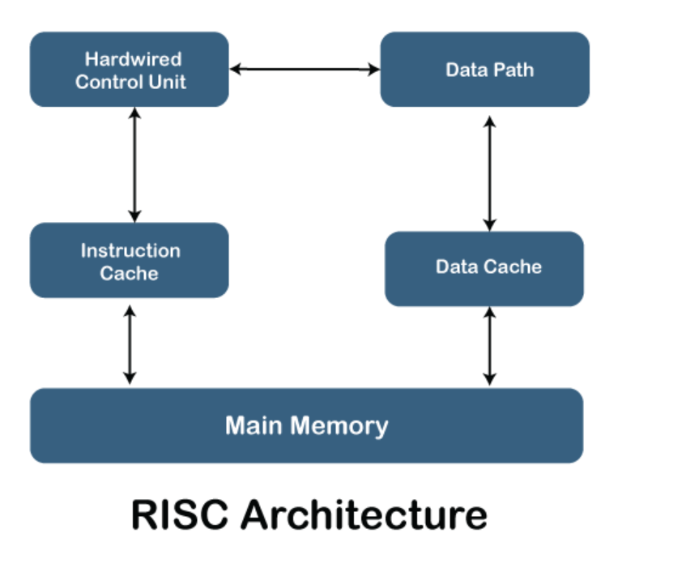

Slide 170
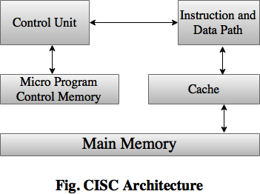
CISC Architecture

